Slide 1

Hornet 7.0 Software Workshop #3

Slide 2
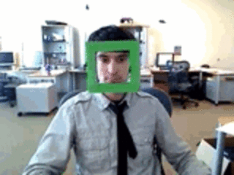
On to Computer Vision!
Without further ado...

Slide 3
Learning Objectives
What is computer vision?
What is OpenCV?
Extracting basic image features
Introduction to advanced image features
Introduction to ROS bagging
Assignment briefing

Slide 4
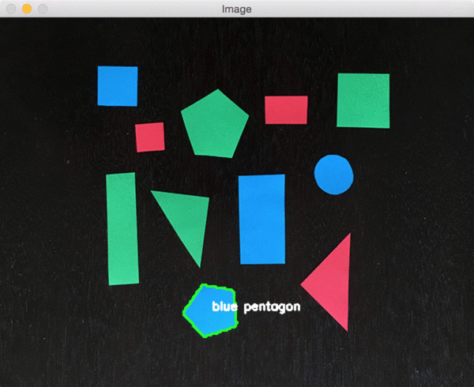

Objective of Computer VIsion
Identify unique features of objects in images...
To segment and classify them and perform useful operations!

Slide 5

OCR

Slide 6
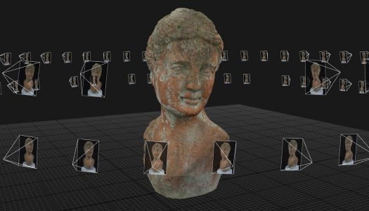
3D model building (photogrammetry)

Slide 7
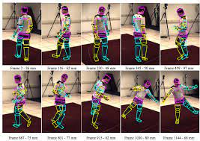
Motion capture (mocap)

Slide 8
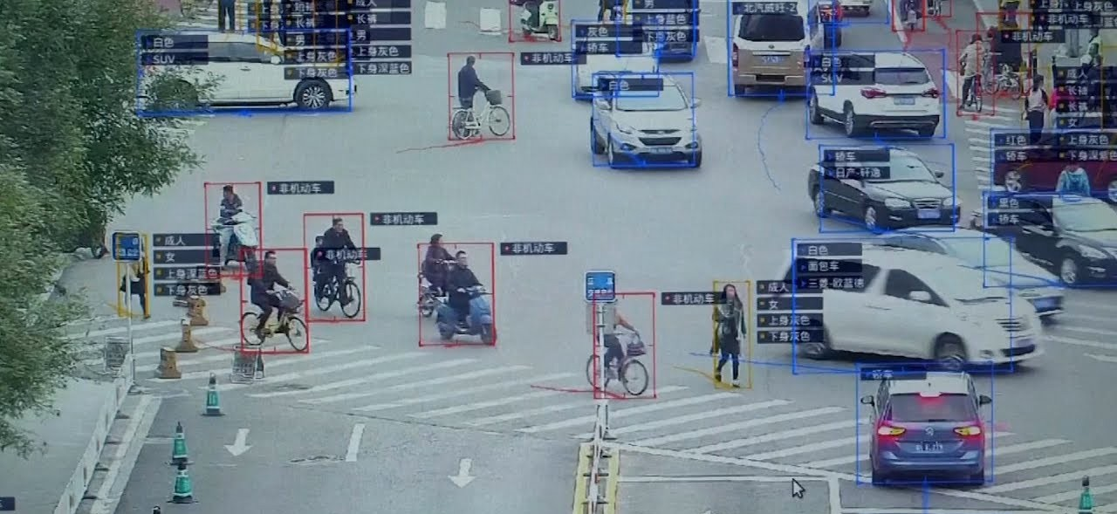
Surveillence

Slide 9
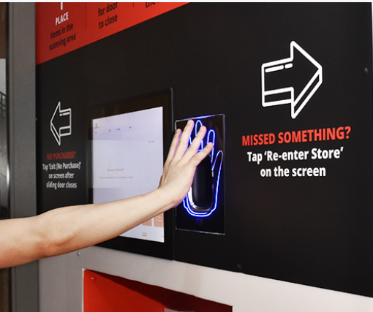
Fingerprint recognition and biometrics

Slide 10
What tools do we use to help with
performing computer vision?

Slide 11

OpenCV is a library of programming functions mainly aimed at real-time computer vision
Has C++, Python, Java and MATLAB interfaces and supports all major operating systems

Slide 12
Check out the documentation!
https://docs.opencv.org/4.4.0/

Slide 13
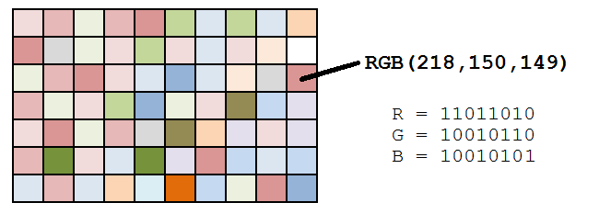
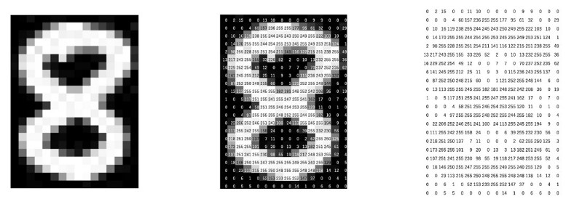
How is an image represented in OpenCV?
Images are basically blocks of numbers (pixels) displayed with different intensities...
...and coloured images have three numbers associated with each pixel to describe its colour (RGB)

Slide 14
Install OpenCV
Install from the terminal
Verify installation
$ sudo apt-get install python-opencv
$ python
>>> import cv2 as cv
>>> print(cv.__version__)

Slide 15
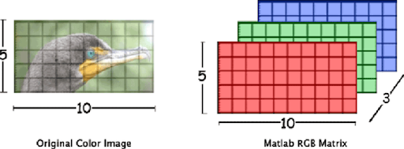
How is an image represented in OpenCV?
OpenCV represents images as matrices (rectangular array of numbers arranged in rows, columns and channels)
-> image operations can be converted to matrix operations and sped up by a GPU
array([[[0, 255, 234],
[1, 245, 230],
...
[5, 234, 34]],
[[10, 200, 150],
...
[10, 203, 132]],
...
[[20, 130, 123],
...
[25, 133, 148]]], dtype=uint8)
For an image of size m x n (row x col)...
one pixel (BGR)
one row of m pixels
n rows of pixels (forming n columns)
Unsigned 8-bit integer (range 0 to 255)

Slide 16
Displaying an image in OpenCV
Download any image into a folder and name it “sample.png”
Create a new python script (not using ROS yet!)
$ ls | grep .png
sample.png
$ nano testCV.py
# grep: globally search for a regular expression and # print matching lines

Slide 17
Displaying an image in OpenCV
#!/usr/bin/env python import numpy as np import cv2 as cv def display(img): cv.imshow("image", img) # show image in a window named "image" cv.waitKey(10000) # wait 10s or until the user presses a key cv.destroyAllWindows() # Clean up, remember to do this! if __name__=='__main__': print(cv.__version__) # print out the opencv version we're using img = cv.imread('sample.png') # load the image display(img)

Slide 18
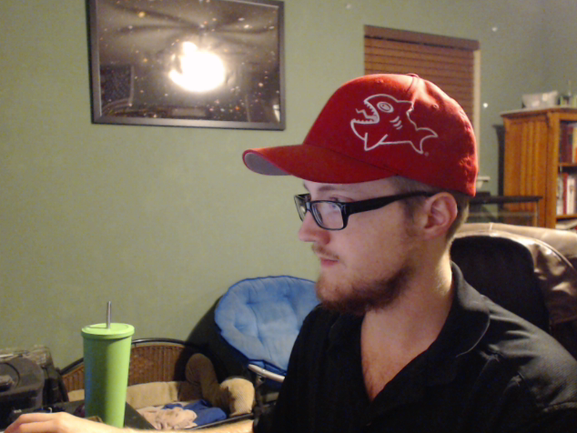
First, let’s use openCV to find the hat!

Slide 19
How do we know it is a hat?
How are we going to guide the computer to find the hat in this image?

Slide 20
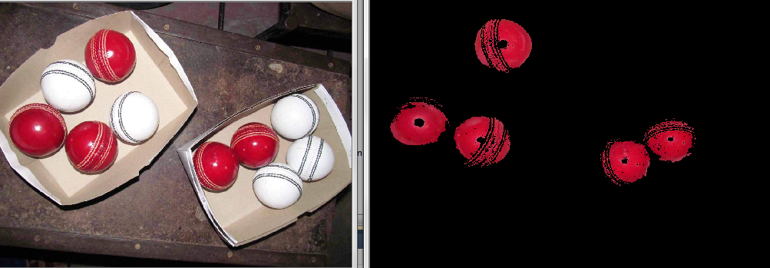
Colour thresholding
Useful for segmenting out objects that are of a colour distinct from the background

Slide 21
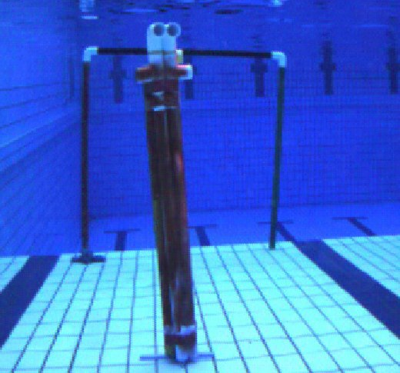
Colour thresholding
Do you see a problem with trying to do this using BGR format?

Slide 22
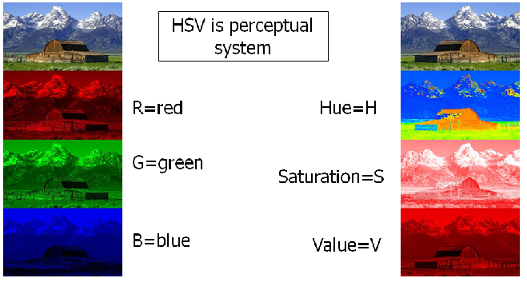
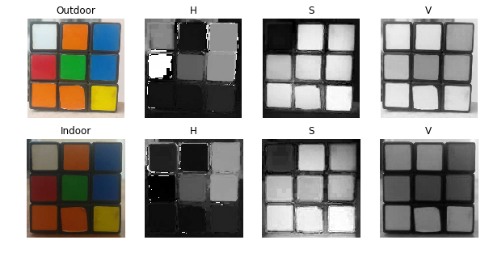
Colour spaces
Images can be presented by other colour spaces in OpenCV (BGR, HSV, LAB, YUV, YCbCr)
✔ Greater invariance (to lighting)
✔ Easier to perform thresholding

Slide 23
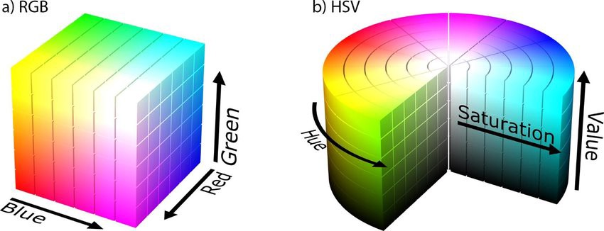
Converting colour spaces
#!/usr/bin/env python import numpy as np import cv2 as cv def display(img): cv.imshow("image", img); # show image in a window named "image" cv.waitKey(10000) # wait 10s or until the user presses a key cv.destroyAllWindows() # Clean up, remember to do this! if __name__=='__main__': print(cv.__version__) # print out the opencv version we're using img = cv.imread('sample.png') # load the image img_hsv = cv.cvtColor(img, cv.COLOR_BGR2HSV) # converts image to HSV colour space
display(img_hsv)

Slide 24
Colour thresholding
Useful for segmenting out objects that are of a colour distinct from the background
Implementation: Figure it out!
Hint:
Use cv2.inRange() for thresholding
Use cv2.bitwise_and() to display results with colour

Slide 25
Obtaining blobs
Objective: To be able to segment out desired blobs after thresholding

Slide 26
Obtaining blobs: common issues
Holes in object
Noisy background

Slide 27
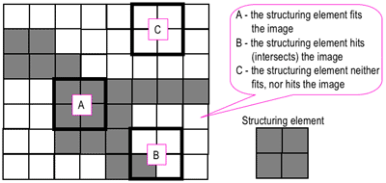
Obtaining blobs: morphological operations
Morphological operations are simple operations you can perform on binary (thresholded) images [mask] using a structuring element [kernel] and a set operator [intersection, union, inclusion, complement]
Most common morphological operations:
Dilation
Erosion
Opening - erosion then dilation
Closing - dilation then erosion

Slide 28
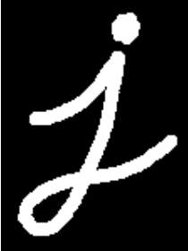
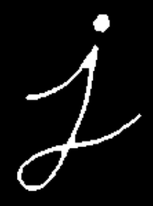

Using morphological operations
img_morph = cv.erode(img, kernel, iterations=1) # SET OPERATOR
img_morph = cv.dilate(img, kernel, iterations=1) # SET OPERATOR

Slide 29
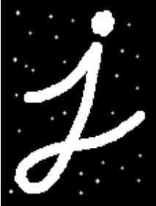

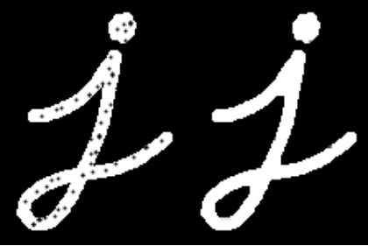
Using morphological operations
img_morph = cv.morphologyEx(img, cv.MORPH_OPEN, kernel, iterations=1) # SET OPERATOR
img_morph = cv.morphologyEx(img, cv.MORPH_CLOSE, kernel, iterations=1) # SET OPERATOR

Slide 30
Using morphological operations
#!/usr/bin/env python import numpy as np import cv2 as cv def display(img): cv.imshow("image", img); # show image in a window named "image" cv.waitKey(10000) # wait 10s or until the user presses a key cv.destroyAllWindows() # Clean up, remember to do this! if __name__=='__main__': print(cv.__version__) # print out the opencv version we're using img = cv.imread('sample.png') # load the image img = cv.imread('sample.png') # MASK, preferably a binary image
kernel = np.ones((3, 3), np.int8) # KERNEL img_morph = cv.erode(img, kernel, iterations=1) # SET OPERATOR
display(img_morph)

Slide 31
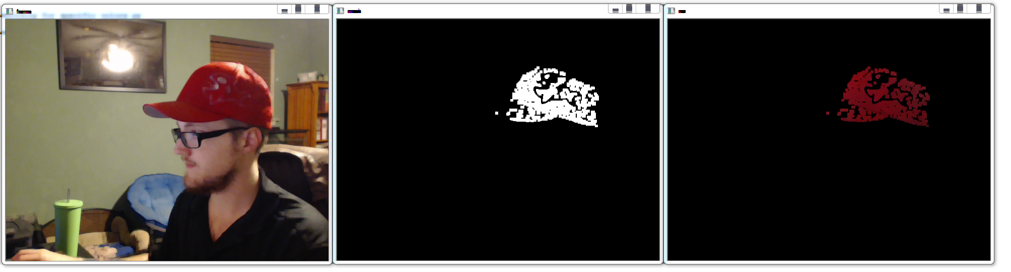
Using morphological operations
Holes in object
open
Noisy background

Slide 32
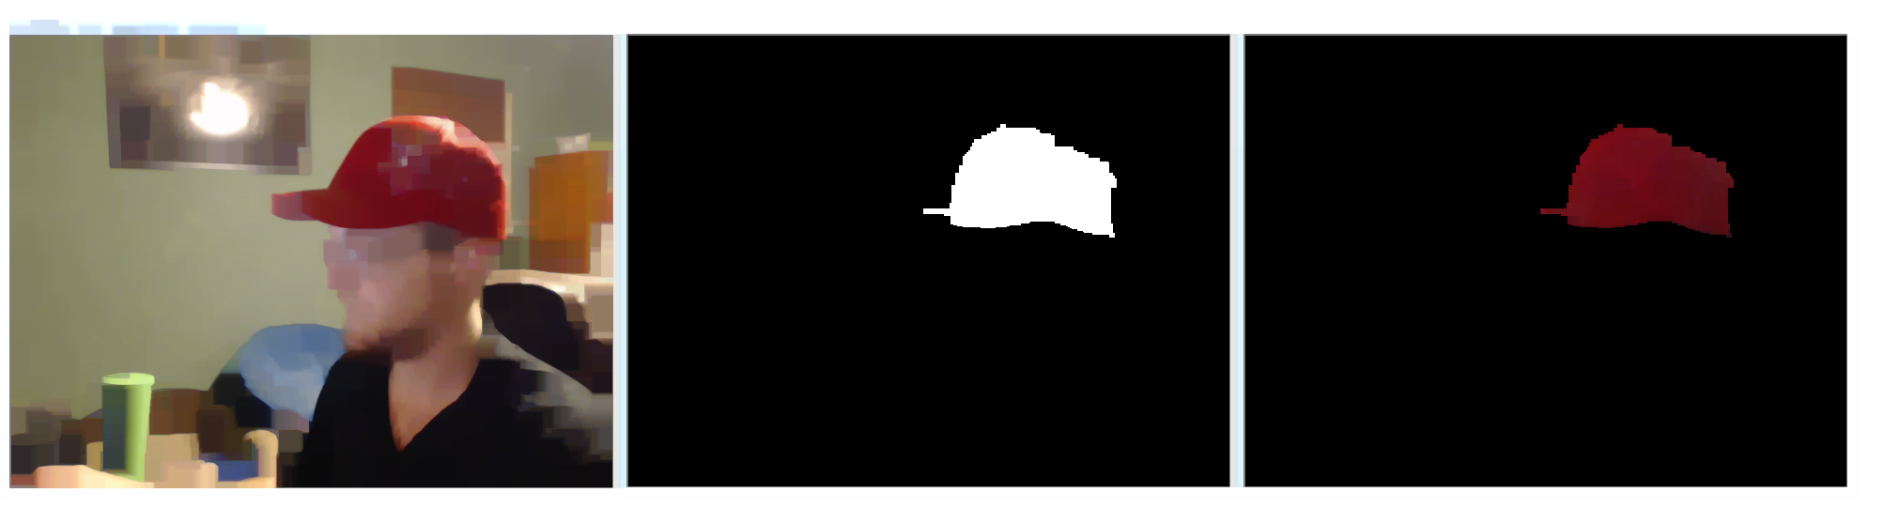
Using morphological operations
Holes in object
close

Slide 33
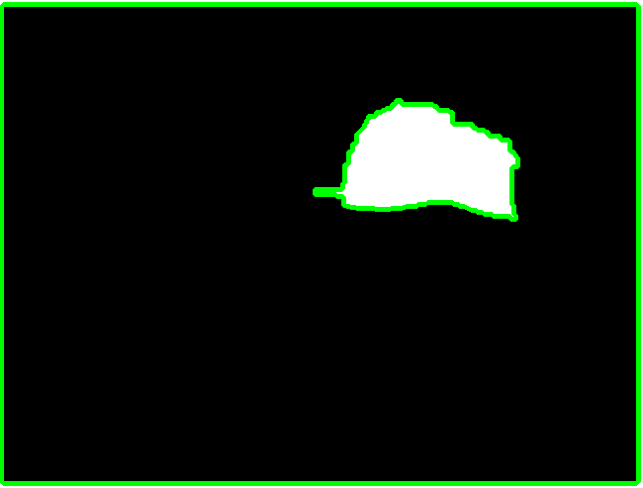
Contours
Contours can be explained simply as a curve joining all the continuous points (along the boundary), having same color or intensity.
Tip: Contouring works better with binary images!
img_gray = cv.cvtColor(img, cv.COLOR_BGR2GRAY) # convert to grayscale thresh = cv.threshold(img_gray, 127, 255, cv.THRESH_BINARY) # get binary images based on intensity contours, hierarchy = cv.findContours(thresh, cv.RETR_LIST,
cv.CHAIN_APPROX_SIMPLE) # find contours
img_contours = cv.drawContours(img, contours, -1, (0,255,0), 3) # draw all contours on original image

Slide 34
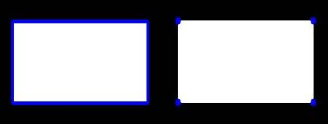
Contours
CHAIN_APPROX_NONE
Contours can be explained simply as a curve joining all the continuous points (along the boundary), having same color or intensity.
Tip: Contouring works better with binary images!
CHAIN_APPROX_SIMPLE
img_gray = cv.cvtColor(img, cv.COLOR_BGR2GRAY) # convert to grayscale thresh = cv.threshold(img_gray, 127, 255, cv.THRESH_BINARY) # get binary images based on intensity contours, hierarchy = cv.findContours(thresh, cv.RETR_LIST,
cv.CHAIN_APPROX_SIMPLE) # find contours
img_contours = cv.drawContours(img, contours, -1, (0,255,0), 3) # draw all contours on original image
Notes:
Chain approximate none stores all the points on the contour but the ch, which saves a lot of memory.

Slide 35
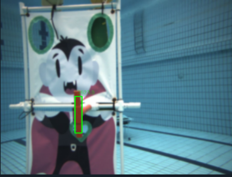
Size: bounding box filtering
Drawing the bounding boxes for all contours:
for c in contours: rect = cv.boundingRect(c) # get the bounding box of this contour x, y, w, h = rect # the bounding box is described with 4 numbers cv.rectangle(img, (x, y), (x + w, y + h), (0, 255, 0), 3) # draw the rectangle on your image cv.putText(img, str(cv.contourArea(c)), (x + 10, y - 10), 0, 0.7, (0, 255, 0)) # print its area
Figure out how you can filter objects based on size!
Use contourArea() and boundingRect() to filter based on pixel size

Slide 36
Common
image features
Colour - BGR / HSV thresholding
Blobs - morphological operations
Contours - edge detection
Size - bounding box filtering

Slide 37
Objective of Computer VIsion
Edges - canny edge detection
Lines - hough line transform
Colour - BGR / HSV thresholding
Shape - polygonal curve approx.
Size - bounding box filtering
Haar-like features
SIFT / SURF features
CNN features etc...
Identify unique features of objects in images...

Slide 38
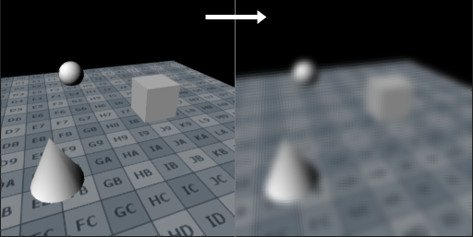
Issues -> pre-processing
Q: My thresholded image is too noisy!
A: Can try using cv2.GaussianBlur() to reduce details and image noise by smoothing out the image

Slide 39
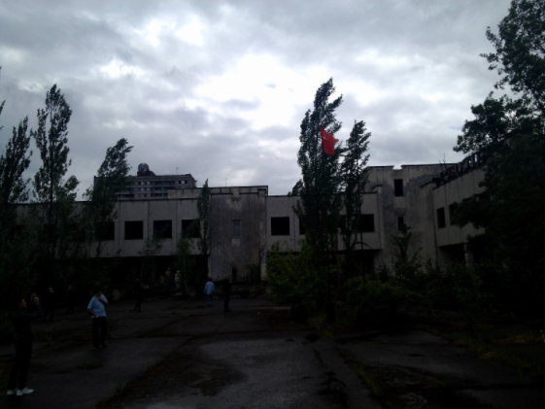
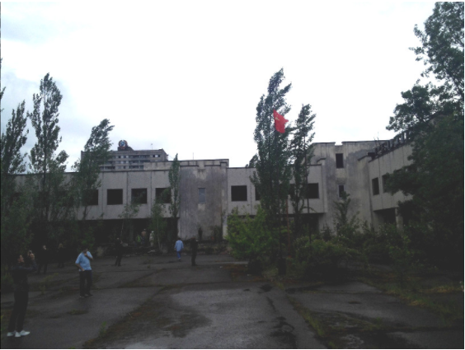
Issues -> pre-processing
Q: My thresholded image is too murky!
A: Can try using gamma correction or histogram equalization to adjust image contrast.

Slide 40
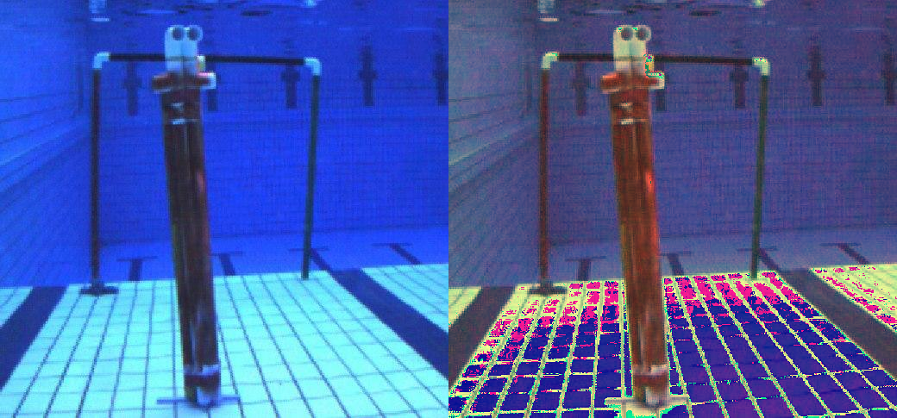
Issues -> pre-processing
Q: My image is too blue!
A: Can perform color balancing using the
gray world algorithm or the simple white
balance algorithm (google it and try to
implement it!)

Slide 41
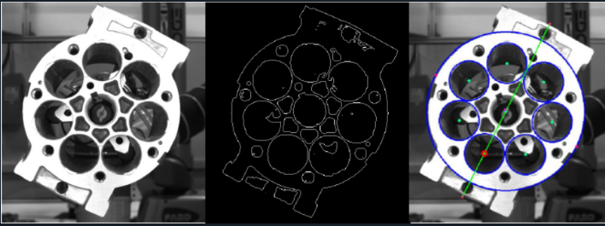
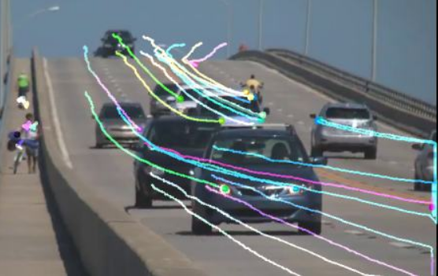
Advanced
image features
Complex objects - Custom detector
Video tracking - optical flow
Deep Learning - convolutional neural network

Slide 42
Preparing for assignment #3: rosbags
Rosbag tools allow you to record data from a running ROS system into a .bag file, and then to play back the data to produce similar behavior in a running system
Note: images are usually
recorded as
CompressedImage.msg
to save disk space
(Imagine recording 3min of
60Hz image footage!)
$ roscore
$ rosbag play assignment3.bag
$ rostopic list
/auv/bot_cam/image_color/compressed
...
$ sudo apt install ros-melodic-image-transport-plugins
$ rqt

Slide 43
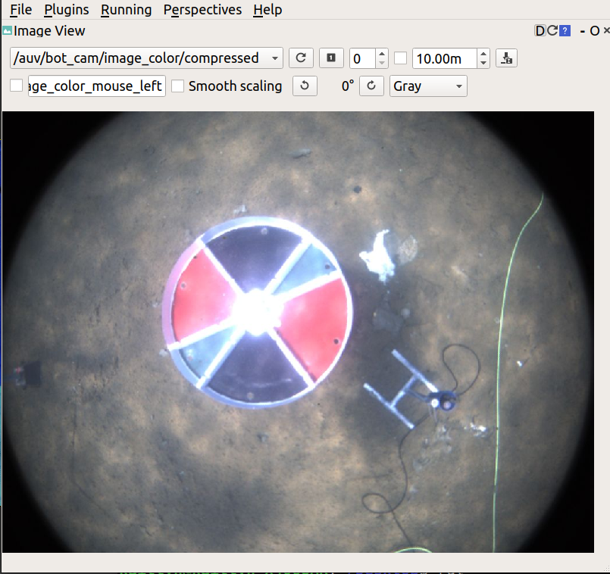
Playing rosbags
In RQT, go to Plugins > Visualisation > Image View
Choose the topic in the dropdown: /auv/bot_cam/image_color/compressed

Slide 44
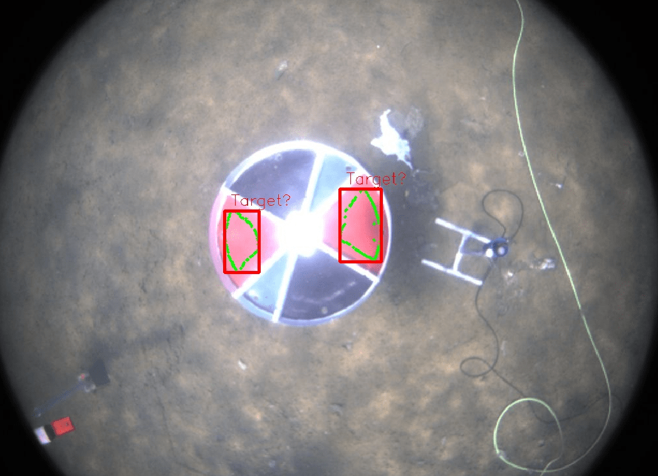
Assignment #3
Download the rosbag “assignment3.bag” file from the Google Drive
Write a node that subscribes to the /auv/bot_cam/image_color/compressed topic (Note that it has to take a CompressedImage.msg!)
Draw a bounding box and/or contour around the red region of the roulette wheel
Be careful!

Slide 45
Assignment #3 (Details)
Try out the different techniques in the pipeline shown today (Pre-processing -> colour space -> thresholding -> morphological operations -> contouring -> bounding box filtering)
Bonus Challenges :)
Try to detect the green region of the roulette wheel
Detect the whole wheel
Publish your output to the topic “/detected/debug_img” as an Image.msg
Publish your output to the topic “/detected/debug_img_compressed” as a CompressedImage.msg

